Slide 1
2D game User Interface
Course : 2D Game Programming
Effective Period : September 2018

Slide 2
These slides have been adapted from: Pereira, V. (2014). Learning Unity 2D Game Development by Example, Packt Publishing, Inc. San Francisco. ISBN: 9781783559046 Chapter 6
Acknowledgement

Slide 3
Learning Objectives
LO 1 : Create 2D game for PC platform
LO 2 : Apply best practices of 2D game development
LO 3 : Design 2D game for PC platform

Slide 4
Principles of User Interface Design
Know your user
Know your user's tasks
Craft an interface suitable to the user and the user's tasks that:
Reduces memory demands
Encourages exploration
Automates menial tasks
Supports novice and expert users
Do these things apply to games?

Slide 5
Know Your User
Can we make any generalization about gamers?
Technical level?
Gender?
Other?

Slide 6
Know Your User
According to surveys, the largest demographic of online game players are middle aged women
Cards
Puzzles
Instead of generalizations, we need to consider the users for particular games
Elderly
Children
“Stereotypical” gamers

Slide 7
Know Your Users
Bartle's Taxonomy: different types of users in “MUDs”
Achiever – get to the “high levels” of the game
Explorer – see all the content
Killer – proving one’s self superior to other players
Socializer – just being around / talking to other players
Many players fall into multiple categories

Slide 8
Know Your User's Tasks
Tasks will vary per game
For example, what are the tasks:
in a puzzle game?
in a RTS?
in an MMO?
Multi-player games are interesting, as they combine aspects of instant messaging with other gameplay aspects
Communication is often a necessary task

Slide 9
User's Tasks
In most applications, tasks are things that a user is using the software for, i.e. a goal to be accomplished
In a game, tasks are effectively artificial, created by the game designers
Tasks in a game are effectively what the game is about, the 'game play‘
What's the difference between game play and UI?

Slide 10
Game Play vs User Interface
Not a clean distinction between these concepts
Game play: what the game lets you do (features)
UI: how you do certain things
Sometimes they are the same thing
a targeting reticule on a shooter
Sometimes they are not
ability to right-click on an object and get a menu

Slide 11
Game Play vs User Interface
A deeper example of this is the crafting system in EverQuest
Ability for players to create in-game items
First version of the interface violated many UI principles:
High memory requirements on user
Very tedious, lots of repetitive clicking
Did not encourage exploration
Combining items incorrectly would get them eaten

Slide 12
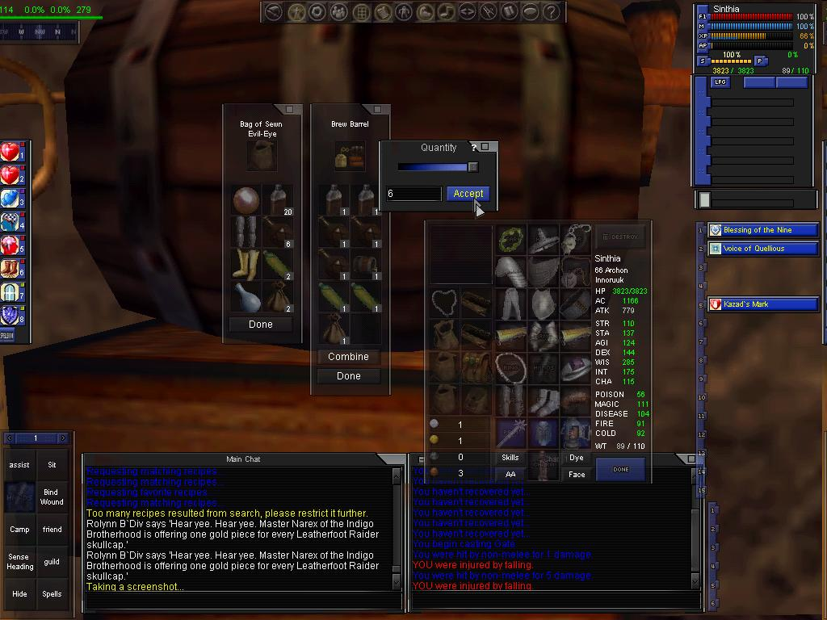
Game Play vs User Interface
Old-style EQ trade skills

Slide 13
Game Play vs User Interface
Newer versions of the interface addressed many of these issues
Lists of known recipies
Automatically removing items from inventory
Not destroying invalid combinations of items
Same in-game mechanism, better UI support

Slide 14
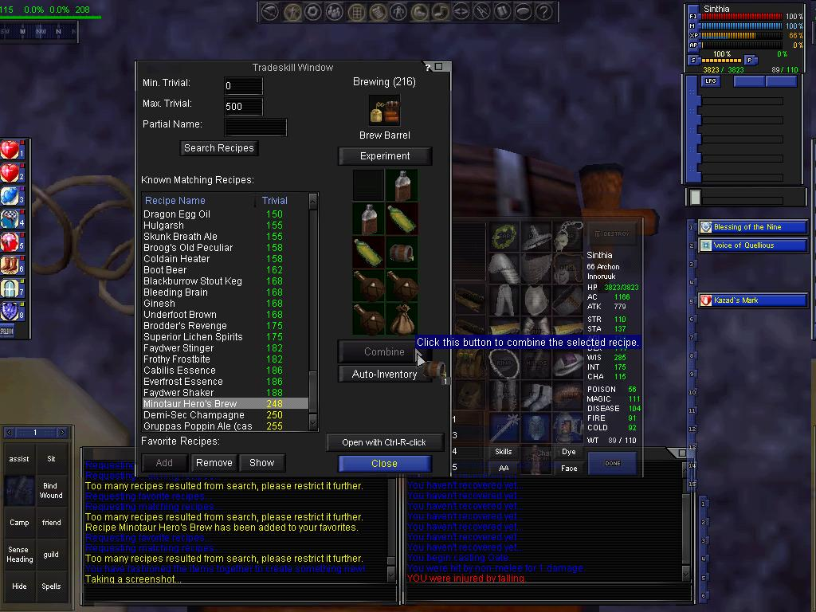
Game Play vs User Interface
New EQ trade skills

Slide 15
Immersion vs Interface
Sometimes the 'traditional parts' of the GUI are part of the game
Flight sims
In a true 'first person' view, might not be a HUD
Halflife 2
Does altering the reality too much break the immersion?
Visual cues that an object can be interacted with that aren’t there in the “real world”

Slide 16
Multi-level Interfaces
Interfaces that accommodate both novice and expert users
In most apps, the UI facilitates the app's tasks
In games, the UI is also there to challenge the user
Often, short cuts that a novice user might use are required to be an "expert" user
Hotkeying production sites in an RTS
In-game macro commands ("/group Attacking $target")
You might have to “raise yourself” to the level of the UI, instead of the other way around!

Slide 17
Case Study: City of Heroes
One of the more popular MMOs on the market today
Super hero genre, very different from the majority of fantasy-based games
A good example of HCI principles applied to a game
Demographic: surprising number of couples play together
Significant others
Father/son

Slide 18
CoH Design Principles
City of Heroes followed many good UI design practices:
Make the obvious choices for a user automatically and let them fix it if they want to.
Don't let the user make a error.
Make common things obvious and trivially easy to do.
Make uncommon things as easy as possible to do, but don't sacrifice the usability of common things to do so.
Minimize surprise, let the user make educated decisions

Slide 19
CoH Tasks
Primary tasks, mapped to keyboard
Movement
Combat
Secondary tasks, mapped to right-click menus
Interaction with other people
Other: managing inventory, setting game options

Slide 20
CoH UI Principles
Error Prevention
Always better to prevent errors before they happen
In the enhancement screen, powers that won't accept the enhancements are insensitive (grayed out)
City of Heroes actually doesn't contain error dialog boxes
Errors from the /command language still occur and are dealt with

Slide 21
CoH UI Principles
User-centered control of information
Chat screens allow filtering of what channels are displayed
Multi-level interfaces
Mission difficulty level can be set by an in-game mechanism
Story related, as to try to keep the level of immersion high
Keyboard "slash commands" and macros
As game user interfaces go, the City of Heroes team did a superb job

Slide 22
Game Interface Design by Brent Faox
The best interfaces have a very distinctive style. They capture the appropriate feel for the game. Great interfaces have a unique look and feel. Good research and a lot of thumbnail sketches can really help you in this creative process.

Slide 23
Define A Look
When working on the look and feel of a game, have fun and take the opportunity to be creative. This is a graet place to experiment and to come up with something totally unique.

Slide 24
Create a Mock-up
The goal of creating this simple art is not to have a final product but to define and visualize the look and feel of the entire interface. A mock-up can guide your design throughout the process. Once your mockup has been created, reviewed and approved, a standard has been set. The rest of the interface can be designed to fit in with the look and feel of the simple art.

Slide 25
Working with Logos
Try to establish the look of the logo early, even if the name must chbange later. Communicate with the publisher and make sure they agree with the direction you are taking

Slide 26
Define A Color Scheme
Color is a very important part of an interface. What color is your game? This is a good question to answer early. Anyone who looks at your interface should be able to see at a glance the color scheme of the entire game.

Slide 27
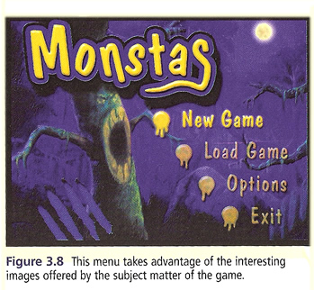
Express Yourself in the Design
Go for it! Make your design unique. This is your chance to really express your creativity. The best interface designs push the feel of the game

Slide 28
Research and Inspiration
Make Lists – Sit down and start writing. Write down good ideas and even ideas that may not seem so good at the moment.
Search for Images – Another great creativity-inspiring technique is is searching the internet for cool, interesting or thought-provoking images.

Slide 29
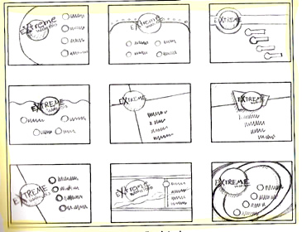
Thumbnails
Work Quickly – Keep your thumbnails small and simple
Push for Variation – You will often be m ore creative the further you go into the thumbnail process.

Slide 30
Illustrations
In place of a photograph, you might want to consider using an illustration.This approach can really improve the look of an interface
The style of illustration used in an interface can help define both the look and feel of a game

Slide 31
Don’t Get Too Attached to Your Ideas
A big mistake many designers often make is to get too attached to an idea early in the design process – they latch on to an idea that sounds appealing and then try to create the rest of the design around this element. It can be hard to do , but if an idea doesn’t work well, you may need to scrap it.

Slide 32
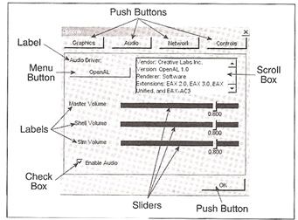
Creating GUI Elements (from Finney page 335)
Generally, we provide the player with a Graphical User Interface for the player to interact with the program. The menu we employ at the start-up of a game, change the setup, or quit – these screens are all examples of GUIs.

Slide 33
User Interface
The UI system allows you to create user interfaces fast and intuitively. This is an introduction to the major features of Unity’s UI system.

Slide 34
Canvas
The Canvas is the area that all UI elements should be inside. The Canvas is a Game Object with a Canvas component on it, and all UI elements must be children of such a Canvas.
Creating a new UI element, such as an Image using the menu GameObject > UI > Image, automatically creates a Canvas, if there isn’t already a Canvas in the scene. The UI element is created as a child to this Canvas.
The Canvas area is shown as a rectangle in the Scene View. This makes it easy to position UI elements without needing to have the Game View visible at all times.
Canvas uses the EventSystem object to help the Messaging System.

Slide 35
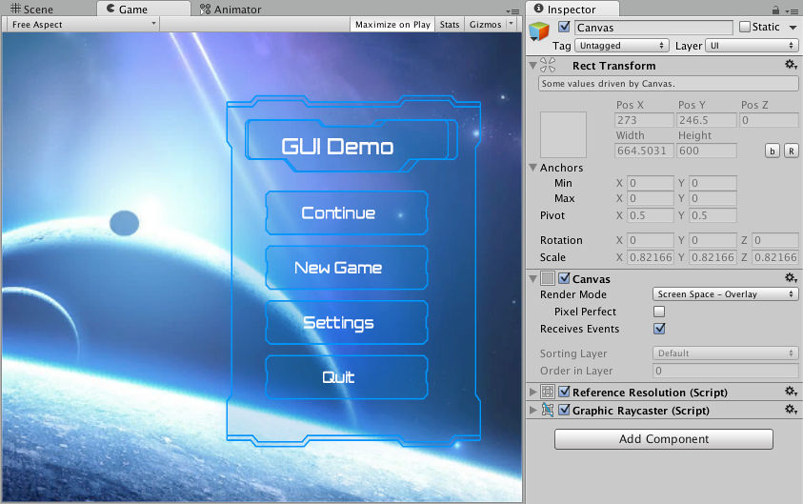
Render Mode
Screen Space - Overlay
This render mode places UI elements on the screen rendered on top of the scene. If the screen is resized or changes resolution, the Canvas will automatically change size to match this.
Image Source:
https://docs.unity3d.com/Manual/UICanvas.html

Slide 36
Render Mode
Screen Space - Camera
This is similar to Screen Space - Overlay, but in this render mode, the Canvas is placed a given distance in front of a specified Camera. The UI elements are rendered by this camera, which means that the Camera settings affect the appearance of the UI. If the Camera is set to Perspective, the UI elements will be rendered with perspective, and the amount of perspective distortion can be controlled by the Camera Field of View. If the screen is resized or changes resolution, or the camera frustrum changes, the Canvas will automatically change size to match as well.
Image Source:
https://docs.unity3d.com/Manual/UICanvas.html

Slide 37
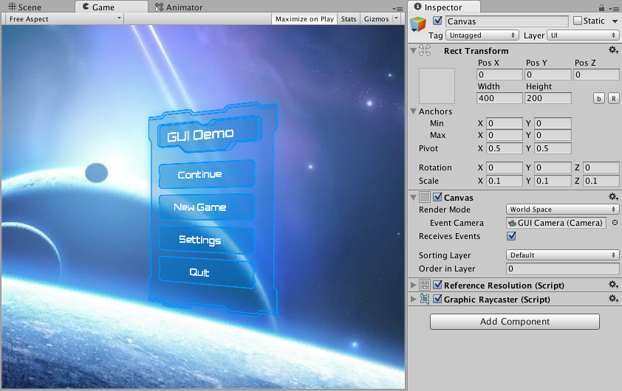
Render Mode
World Space
In this render mode, the Canvas will behave as any other object in the scene. The size of the Canvas can be set manually using its Rect Transform, and UI elements will render in front of or behind other objects in the scene based on 3D placement. This is useful for UIs that are meant to be a part of the world. This is also known as a “diegetic interface”.
Image Source:
https://docs.unity3d.com/Manual/UICanvas.html

Slide 38
Basic Layout
The Rect Tool
Every UI element is represented as a rectangle for layout purposes. This rectangle can be manipulated in the Scene View using the Rect Tool in the toolbar. The Rect Tool is used both for Unity’s 2D features and for UI, and in fact can be used even for 3D objects as well.

Slide 39
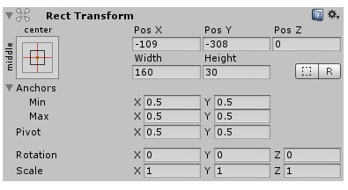
Basic Layout
Rect Transform
The Rect Transform is a new transform component that is used for all UI elements instead of the regular Transform component.
Image Source:
https://docs.unity3d.com/Manual/UICanvas.html

Slide 40
Basic Layout
Rect Transform
Resizing Versus Scaling
When the Rect Tool is used to change the size of an object, normally for Sprites in the 2D system and for 3D objects it will change the local scale of the object. However, when it’s used on an object with a Rect Transform on it, it will instead change the width and the height, keeping the local scale unchanged. This resizing will not affect font sizes, border on sliced images, and so on.
Pivot
Rotations, size, and scale modifications occur around the pivot so the position of the pivot affects the outcome of a rotation, resizing, or scaling. When the toolbar Pivot button is set to Pivot mode, the pivot of a Rect Transform can be moved in the Scene View.
Anchors
Rect Transforms include a layout concept called anchors. Anchors are shown as four small triangular handles in the Scene View and anchor information is also shown in the Inspector.

Slide 41
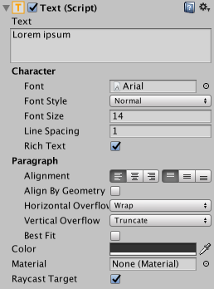
Visual Components
With the introduction of the UI system, new Components have been added that will help you create GUI specific functionality. This section will cover the basics of the new Components that can be created.
TEXT
The Text component, which is also known as a Label, has a Text area for entering the text that will be displayed. It is possible to set the font, font style, font size and whether or not the text has rich text capability.
There are options to set the alignment of the text, settings for horizontal and vertical overflow which control what happens if the text is larger than the width or height of the rectangle, and a Best Fit option that makes the text resize to fit the available space.
Image Source:
https://docs.unity3d.com/Manual/UICanvas.html

Slide 42
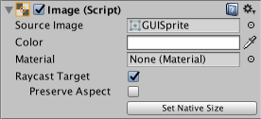
Visual Components
With the introduction of the UI system, new Components have been added that will help you create GUI specific functionality. This section will cover the basics of the new Components that can be created.
IMAGE
An Image has a Rect Transform component and an Image component. A sprite can be applied to the Image component under the Target Graphic field, and its colour can be set in the Color field. A material can also be applied to the Image component. The Image Type field defines how the applied sprite will appear, the options are:
Simple - Scales the whole sprite equally.
Sliced - Utilises the 3x3 sprite division so that resizing does not distort corners and only the center part is stretched.
Tiled - Similar to Sliced, but tiles (repeats) the center part rather than stretching it. For sprites with no borders at all, the entire sprite is tiled.
Filled - Shows the sprite in the same way as Simple does except that it fills in the sprite from an origin in a defined direction, method and amount.
Image Source:
https://docs.unity3d.com/Manual/UICanvas.html

Slide 43


Interaction Components
Button
Toggle
A Button has an OnClick UnityEvent to define what it will do when clicked.
A Toggle has an Is On checkbox that determines whether the Toggle is currently on or off. This value is flipped when the user clicks the Toggle, and a visual checkmark can be turned on or off accordingly. It also has an OnValueCHanged UnityEvent to define what it will do when the value is changed.

Slide 44
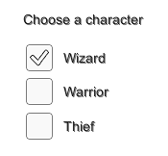

Interaction Components
Toggle Group
Slider
A Toggle Group can be used to group a set of Toggles that are mutually exclusive. Toggles that belong to the same group are constrained so that only one of them can be selected at a time - selecting one of them automatically deselects all the others.
A Slider has a decimal number Value that the user can drag between a minimum and maximum value. It can be either horizontal or vertical. It also has a OnValueChanged UnityEvent to define what it will do when the value is changed.
Image Source:
https://docs.unity3d.com/Manual/UICanvas.html

Slide 45


Interaction Components
Scrollbar
Dropdown
A Scrollbar has a decimal number Value between 0 and 1. When the user drags the scrollbar, the value changes accordingly.
The Scrollbar can be either horizontal or vertical. It also has a OnValueChanged UnityEvent to define what it will do when the value is changed.
Dropdown has a list of options to choose from. A text string and optionally an image can be specified for each option, and can be set either in the Inspector or dynamically from code. It has a OnValueChanged UnityEvent to define what it will do when the currently chosen option is changed.
Image Source:
https://docs.unity3d.com/Manual/UICanvas.html

Slide 46
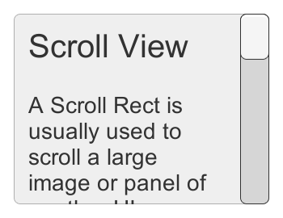

Interaction Components
Input Field
Scroll Rect
An Input Field is used to make the text of a Text Element editable by the user. It has a UnityEvent to define what it will do when the text content is changed, and an another to define what it will do when the user has finished editing it.
A Scroll Rect can be used when content that takes up a lot of space needs to be displayed in a small area. The Scroll Rect provides functionality to scroll over this content.
Image Source:
https://docs.unity3d.com/Manual/UICanvas.html

Slide 47
AutoLayout
The Rect Transform layout system is flexible enough to handle a lot of different types of layouts and it also allows placing elements in a complete freeform fashion. However, sometimes something a bit more structured can be needed.
The auto layout system provides ways to place elements in nested layout groups such as horizontal groups, vertical groups, or grids. It also allows elements to automatically be sized accoring to the contained content. For example a button can be dynamically resized to exactly fit its text content plus some padding.
The auto layout system is a system built on top of the basic Rect Transform layout system. It can optionally be used on some or all elements.

Slide 48
Understanding Layout Elements
The auto layout system is based on a concept of layout elements and layout controllers. A layout element is an Game Object with a Rect Transform and optionally other components as well. The layout element has certain knowledge about which size it should have. Layout elements don’t directly set their own size, but other components that function as layout controllers can use the information they provide in order to calculate a size to use for them.
A layout element has properties that defines its own:
Minimum width
Minimum height
Preferred width
Preferred height
Flexible width
Flexible height

Slide 49
Discussion
What is the used of UI?
Why UI is so important?
Does UI need to be blended to the gameplay element?

Slide 50
References
Calabrese, D. (2014). Unity 2D Game Development. Packt Publishing, Inc. San Francisco. ISBN: 9781783559046
Freeman, J. (2015). Unity’s New 2D Workflow
Vidyasagar. (2014. Unity and C#: Game Loop.CodeProject
Pereira, V. (2014). Learning Unity 2D Game Development by Example. Packt Publishing, Inc. San Francisco. ISBN: 9781783559046
Unity. (2016). Unity Manual Documentation. http://docs.unity3d.com/Manual/

